Slide 1
Welcome to cs50 Section!
Please form groups of 3 and start the activity!

Slide 2
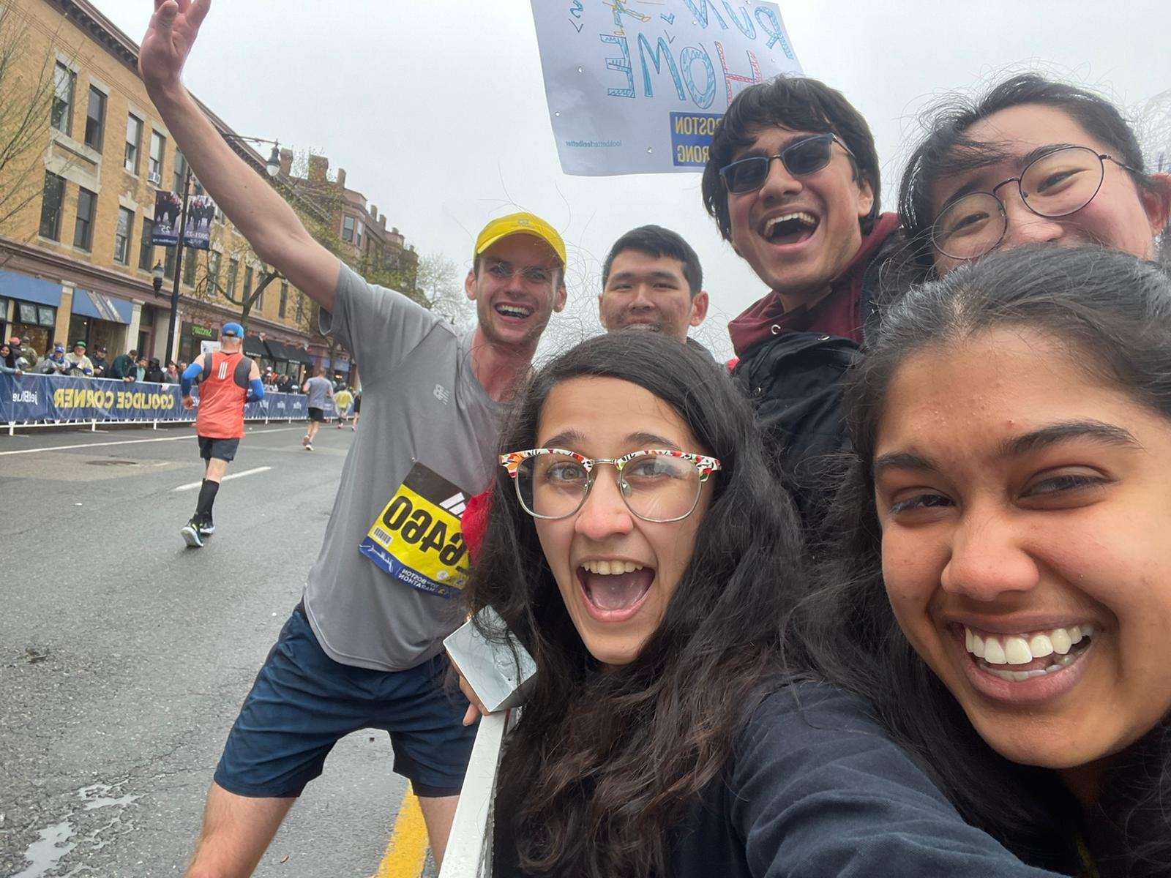
Andrew Holmes Cabot House, Senior
B.A. in Computer Science
Some of my passions:
Running
Soccer
Dog walking & hiking
Card & board games
Video games
Teaching!
aholmes@college.harvard.edu

Slide 3
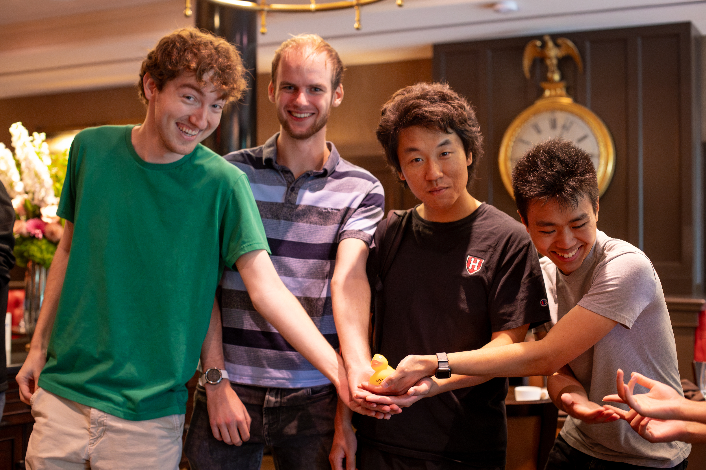
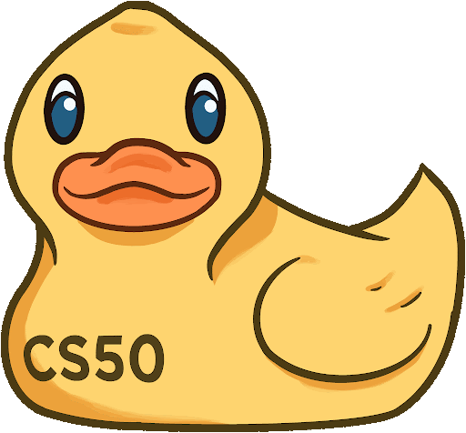
My Teaching
Fall 2021: CS50 CA
Spring 2022: CS51 CA
Fall 2022: CS50 TF
Spring 2022: CS124 TF
Fall 2023: CS50 Head TF

Slide 4
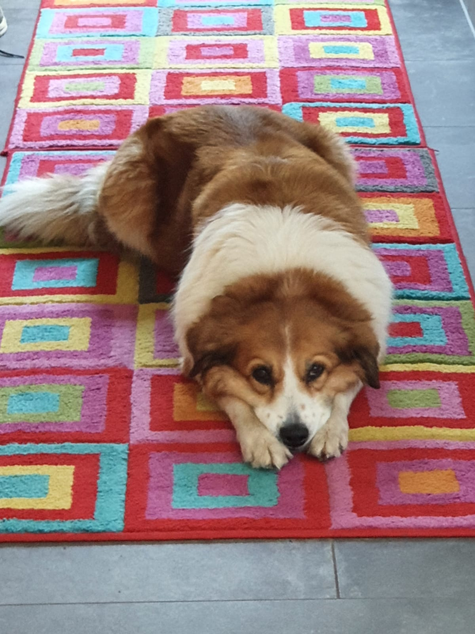
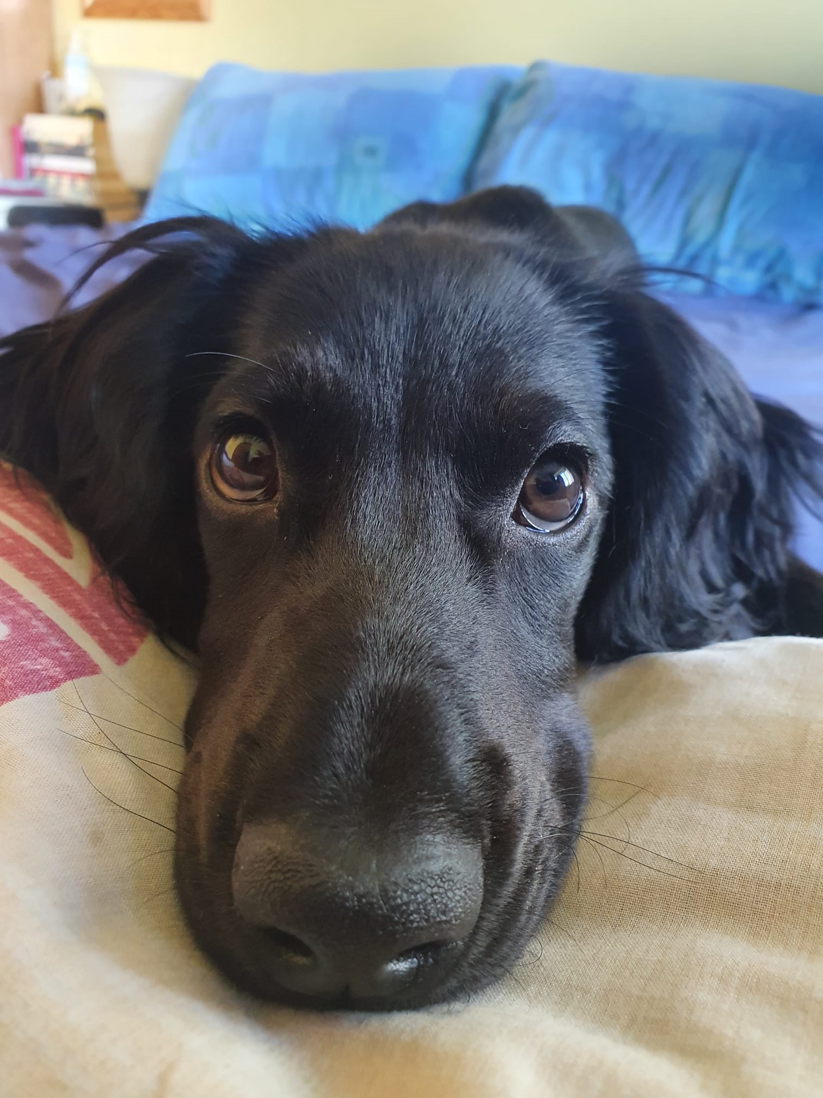
My Classes
Current
CS165: Data Systems
CS153: Compilers
EXPOS 40: Public Speaking
?
Past (CS-related)
CS124, CS181, CS182, CS262, CS238, CS91, CS121, CS61, CS51, CS50, STAT110, Math22a, Math22b

Slide 5
cs50 section 1
Intro to C
Andrew Holmes, Fall 2023

Slide 6
Today’s Plan
Scratch → C
C Syntax dive
01
03
Writing your code
Lab – Hello!
02
04
From blocks to your first lines of code :)
Delving deeper into C’s syntax!
Getting setup with cs50.dev and writing some code!
Tackle Lab 1.

Slide 7
01
Scratch → C
Converting our Scratch understanding to our first programming language!

Slide 8


Basic Scratch program
Scratch → C

Slide 9
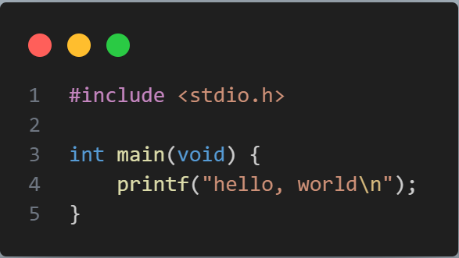
C Equivalent for hello world
Scratch → C

Slide 10
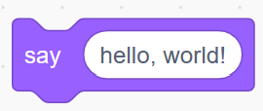
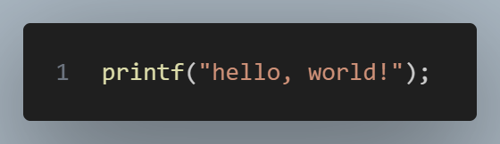
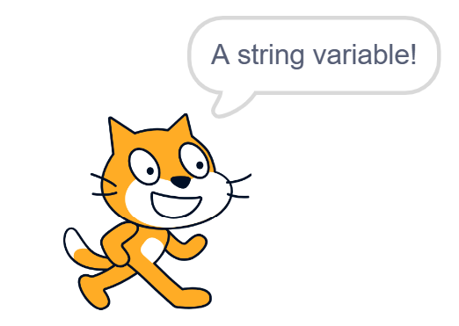
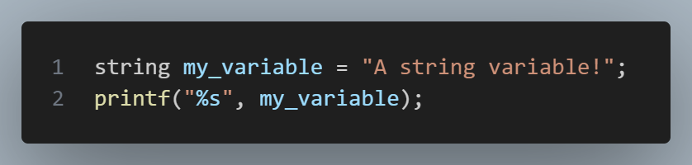
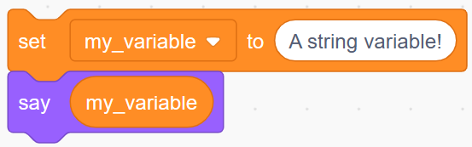
Scratch ‘say’, C printf
Scratch → C

Slide 11
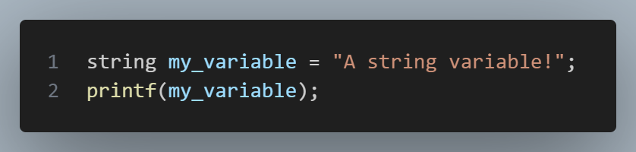
Scratch → C
VS
DON’T DO THIS ONE. IT CAN BE USED BY HACKERS TO EDIT YOUR MEMORY.

Slide 12
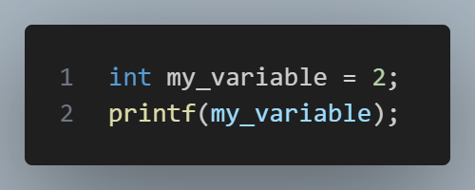
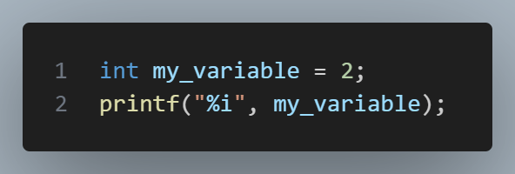
It also prevents…
Scratch → C
INVALID C syntax. printf REQUIRES a string as input.
VALID C. my_variable is an int, but is parsed formatted as a string.

Slide 13
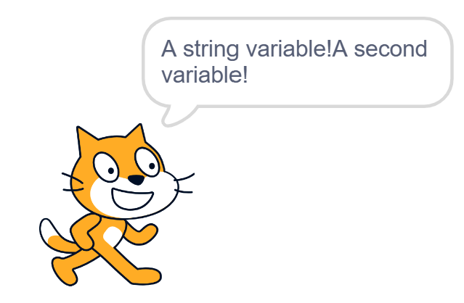
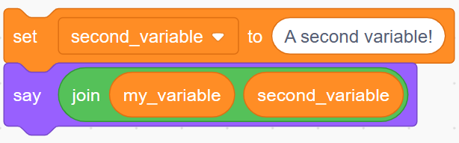
Scratch ‘say’, C printf
Scratch → C

Slide 14
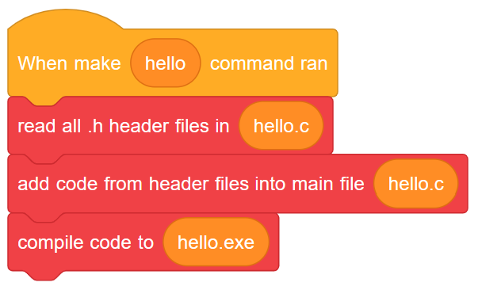
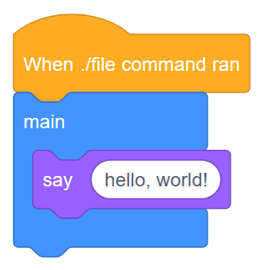
The whole process, in Scratch terms

Slide 15
02
Writing code
Getting used to cs50’s tools, mainly cs50.dev.

Slide 16
03
C deep dive
Understanding C syntax better!

Slide 17
Whitespace
C syntax

Slide 18
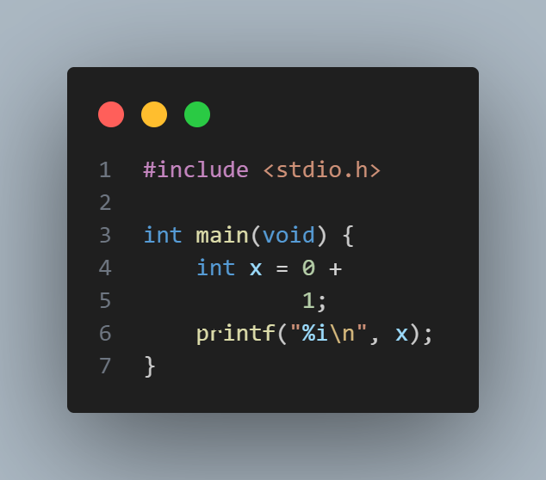
Valid C? (1)
Write your answer here. Is this valid C code? Why or why not? If not, explain how to fix it. What do you think it does?

Slide 19
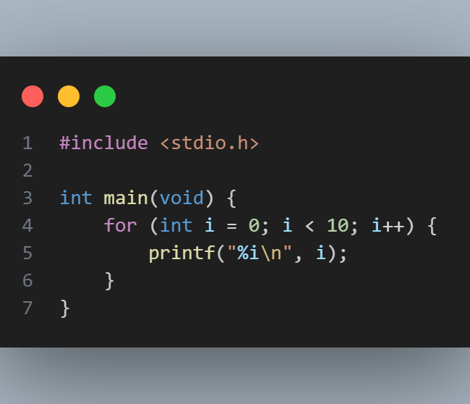
Valid C? (2)
Write your answer here. Is this valid C code? Why or why not? If not, explain how to fix it. What do you think it does?

Slide 20
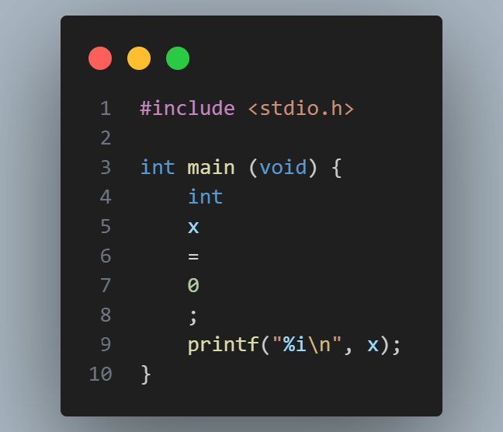
Valid C? (3)
Write your answer here. Is this valid C code? Why or why not? If not, explain how to fix it. What do you think it does?

Slide 21
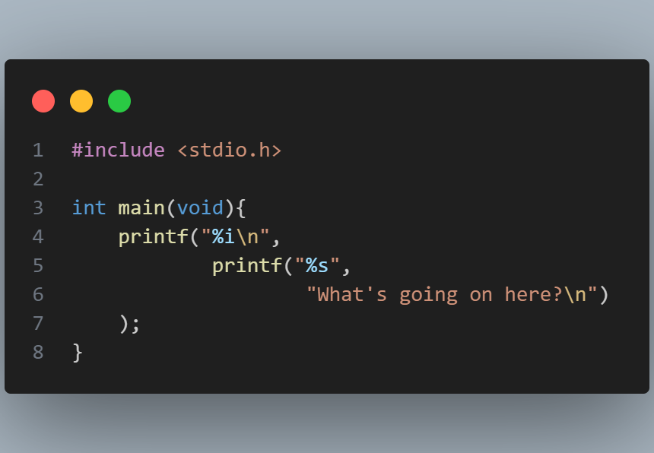
Valid C? (4)
Write your answer here. Is this valid C code? Why or why not? If not, explain how to fix it. If it is valid, what do you think it does?

